Slide 1




Writing strong funding applications
Robert Smith & Sophie Satchell
Enterprise Support Alliance
On behalf of High Peak Borough Council

Slide 2




Housekeeping

Slide 3
Partners and funding

Slide 4

Agenda
9:30 | Welcome and introductions
9:55 | What makes a good funding application
10:50 | Break
11:00 | What makes a good funding application con’t
11:40 | The search for funding
11:50 | Quick quiz
12:05 | Support
12:10 | HPBC UKSPF grants
12:20 | Q&A
12:30 | Close

Slide 5
Tell us about you!
Introduce yourself
Tell us your name, who you are representing today and briefly about your experience of making grant applications!
Sophie and I will start!

Slide 6
Aims & objectives
Objectives for today’s session
Develop your understanding & knowledge of applying for grant funding
Increase preparedness of organisations to apply for grants
Increase knowledge of grant search techniques
To identify provision of the toolkit to assist with future funding activities
Aim for the programme
Strengthen the ability amongst attendees and their organisations to make strong and successful grant applications

Slide 7

What makes a strong funding application - Fundamentals
Let’s explore some of the basic or fundamental steps - What do you think is going to appear below?
Are you eligible?
Have you read the criteria?
Have you read it thoroughly?
Do you understand what the funder wants to invest in?
Can you demonstrate that your project is a good fit?
Can you develop a compelling and clear case for funding?
Can you demonstrate (evidence) the need/demand?
Can you demonstrate innovation?
Can you resource the project?
Do you know what it costs?
Can you demonstrate a good track record?
Can you show and measure your impact?
If your answer to these questions is yes – carry on

Slide 8
What makes a strong funding application – What is the project going to do?
Aim and objectives – know the difference
Demonstrate, provide examples, explain, very clearly – how the project fits with the funders aims!
what the project is going to do
how it works
how it will be delivered
who does what and who is responsible for what
when things are going to happen
Are you going to/have you used Co production/design to develop/deliver the project?
What difference it is going to make? More on this to follow!
Action
Draft a programme of work
Start to identify your impacts/outcomes

Slide 9
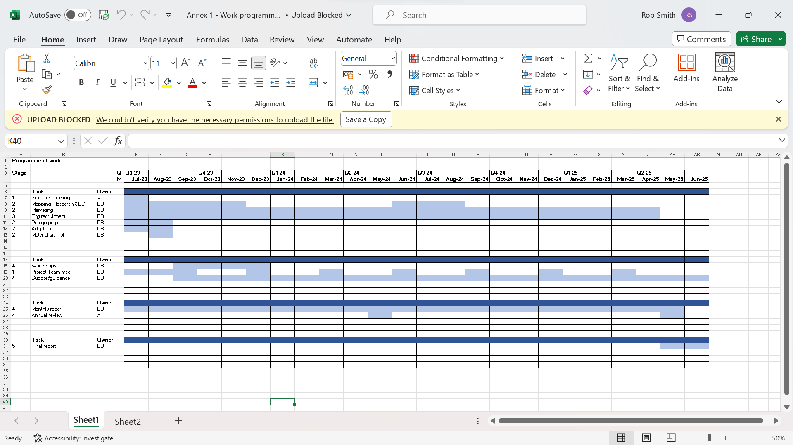
Chronology

Slide 10

What makes a strong funding application – Need for the project
Explain, demonstrate, describe very clearly –
Evidencing both need and demand - What is the difference?
Research
Indices of deprivation
Umbrella bodies
Reports and/or examples from other agencies
Surveys/Data
Feedback from users and partners
Co-design/Production
Remember to show source!
Actions
Collate all research to back up what you want to do – it is your evidence that is key
Notes:
Diving into a crucial aspect of crafting a compelling funding application: gathering solid evidence to support your cause. Let's explore how research becomes the backbone of your proposal.
1. Evidencing Need and Demand
First things first—let's distinguish between 'need' and 'demand'. Need is the gap or the problem that exists, while demand is the interest or desire for a solution. Your research should paint a crystal-clear picture of both aspects.
2. Sources of Research
Where do you find this treasure trove of evidence? Here are some pointers:
Indices of Deprivation: A helpful tool to identify areas or communities in need.
Umbrella Bodies: Organisations that gather data or insights related to your cause.
Reports & Examples: Seek inspiration from similar agencies or projects to reinforce your proposal. Using this empirical evidence shows your project will work.
Surveys & Data: Hard numbers and statistics paint a vivid picture of the situation.
User & Partner Feedback: Authentic voices that validate your approach.
Co-design/Production: Collaborative efforts demonstrate community involvement and efficacy.
3. Don't Forget Your Sources!
Citing your sources isn't just a formality—it's a mark of credibility. Make sure you show where your evidence is coming from!
4. Action Time
Now, what do you do with all this research? It's not just for show—it's your ammunition. Compile and organize it to support every aspect of your proposal. Remember, this evidence is the key to unlocking those funding doors!
Conclusion
Research isn't just about collecting facts; it's about telling a compelling story backed by data and real experiences. It's about giving life to your ideas and proving why they matter.
So, dive deep, gather those nuggets of information, and let your evidence speak volumes for the change you want to create!
Remember: Evidence isn't just a nice addition—it's the heart of your application.

Slide 11


Do your research
Find out if there something similar happening - is there another supplier
Academic research – evidence of need
Precedents – has someone done it successfully before
Metrics – numbers are powerful!
Anecdotal information – also powerful!
Surveys
Umbrella bodies – often have information
Use both Qualitative & Quantitative
Consider pictograms, Word clouds and other graphics
Make it compelling but easy to understand
Paraphrase
Remember to source!

Slide 12
What makes a strong funding application – Outputs & Outcomes
Outputs and Outcomes – what is the difference?
Outputs - the tangible results produced during a project, can often be counted
Outcomes - are the broader impacts or changes that result from those outputs – reflecting the difference or impact that a project will make
Outputs
Outputs are important – they show what is happening within the project and help track progress
Often, they will be metric or something tangible
Often revolve around the number of activities; attendees; number of widgets produced; additionality
Show what is happening during the time the project is live
Will often be used as simple targets by funder
By reaching output targets you will usually achieve your outcomes!

Slide 13
What makes a strong funding application – Outputs & Outcomes
Outcomes
Outcomes are critical - it is the impact of the project, what difference will it make, what changes!
Outcomes should be logically presented – ‘x’ will lead to ‘y’ which means that ‘z’ will be achieved, with ‘z’, (the outcome), being something that you know the funder is seeking to achieve.
Outcomes should be measured and/or evidence-based using examples.
If using rationale or making assumptions e.g., ‘it is reasonable to assume’ be realistic.
Consider the following carefully
Which outcomes matter most to the funders?
Do outcomes contribute to service sustainability?
How is this project going to stop the issue happening in the future?
Action
Work out carefully what difference a project is going to make
Identify how will you measure/demonstrate it
Notes:
Example: saving money leads to financial stability which leads to less stress.
Going to school earns you qualifications which leads to employment.
Baking leads to a crumble sitting in front of you, which makes you happy

Slide 14
What makes a strong funding application – Outputs & Outcomes
Health Awareness Campaign
Output: Creation of educational brochures, posters, and online materials about the importance of regular exercise and healthy eating habits.
Outcome: Increased awareness among the target population about the benefits of a healthy lifestyle, leading to a decrease in obesity rates and related health issues in the community.
Environmental Conservation Project
Output: Restoration of a degraded wetland ecosystem through habitat restoration, invasive species removal, and 25 community education initiatives.
Outcome: Enhanced biodiversity and ecosystem resilience, leading to improved water quality, flood regulation, and recreational opportunities for local residents.
Grant workshops programme - Writing Strong Funding Applications
Output: ?
Outcome: ?
Train 50 individuals from locality
Delegates with enhanced skills, likely to make more successful grant applications, bringing more funds into locality and improving facilities and services locally

Slide 15
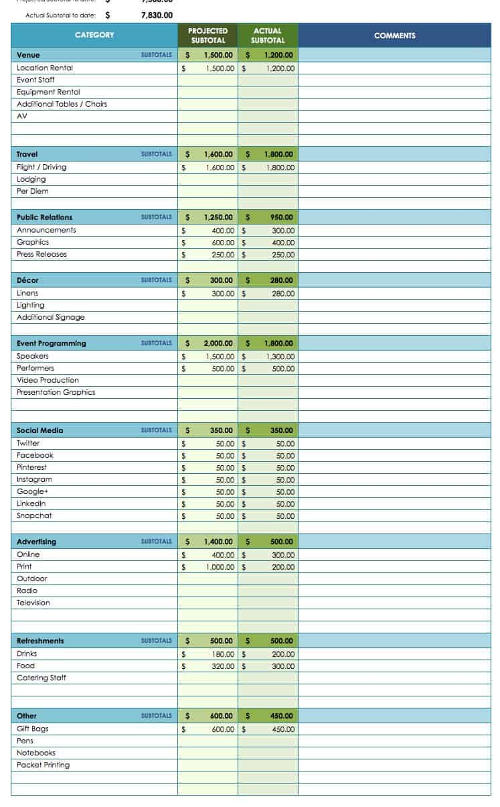
What makes a strong funding application - Costs
Costs
Costs need to be very clear - itemise everything – use a spreadsheet to show your costs - toolkit version
Get quotes – any reputable supplier will provide quotes – discuss chronology as some will be timebound
Capital and revenue costs – what does the funder support?
Match funding – this varies e.g., HPBC-UKSPF 20% match required – another programme we are working on requires 50% match - this can be make or break
Almost always in cash and you will have to have it before grant – check what funder allows
Worth exploring ‘match in kind’ i.e.,– usually worked out by calculating staff time
Will a Procurement process be required?
Action
Work out and present costs accurately
Work out how much match you need and how you are going to source it

Slide 16
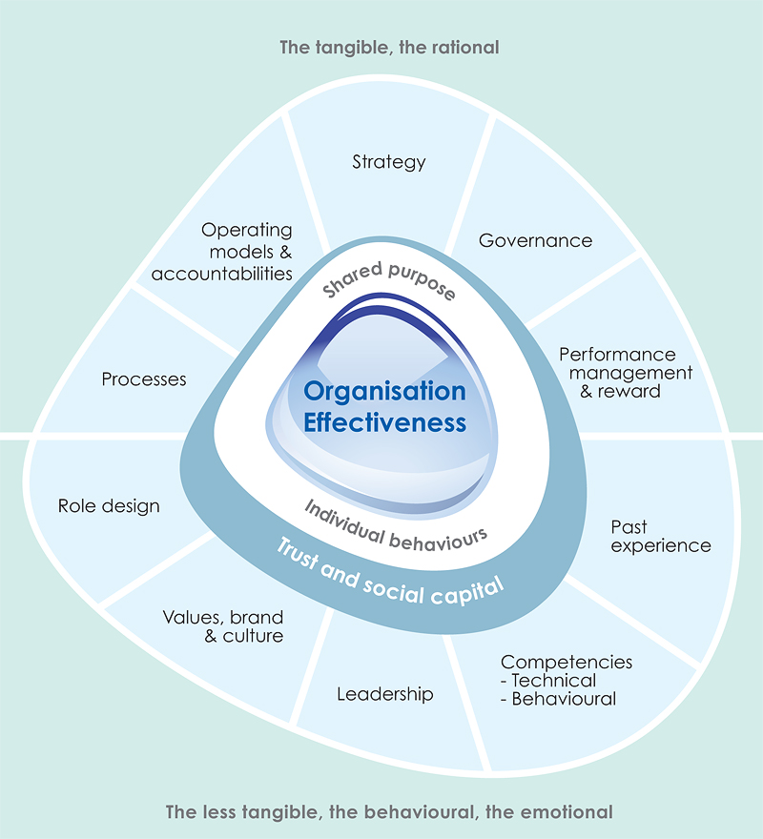
What makes a strong funding application – The applicant
Your organisation
Funders will want to see that you are a ‘well managed’ organisation
That you can demonstrate a good track record
You are being innovative
You involve the beneficiaries in designing project (Co Design & Co Production)
You work in partnership
You have support
You can demonstrate resourcing
You have accreditations
Action
Collect evidence
Get testimonials

Slide 17
What makes a strong funding application – The applicant
You will often be asked what policies your organisation has.
You probably have most of the policies you are required to have in place already but check what the application requires, we are seeing a lot more requirements for policies around sustainability for example
Funders will include this as part of the due diligence testing
Without the required policies it may be an instant fail, or in a competitive environment it may mean other applicants beat you to the funding
Action
Check what policies you have in place
Add commonly required policies
Fill any gaps

Slide 18
What makes a strong funding application – The applicant
Quality assurance - demonstrate your commitment to quality
Emphasize sustainability – incorporate sustainable practices
Emphasize Ethical Standards e.g., anti-bribery, anti-corruption, modern slavery etc
Continuous improvement – demonstrate learning from other projects and live improvements/adaptions if appropriate
Value proposition – emphasize how your offer meets their needs better than others – research competitors!
Suggested action
Internal - develop a competitive pricing strategy balancing profitability with affordability
for the contractor

Slide 19
What makes a strong funding application - Funders policies
You will often be asked how your application contributes to other policies.
These policies can and will vary but some examples include
Net Zero, Nature Recovery or similar
Local policies - e.g., the funder; a borough or district council’s policies
Policies that relate to the target audience or sector that you are working in
You will need to read and understand these policies and, importantly, demonstrate how your application contributes to these
Action
Identify & Demonstrate how your application aligns with funders policies

Slide 20


Comfort break
Back in ten!

Slide 21
What makes a strong funding application – Risk assessment
Develop your risk assessment
It is always a good exercise to do for your own benefit
It shows funders that you have thought about the risks the project faces or may face
More importantly, it shows funders that you have taken steps to mitigate your risks
RR Example
Risk register document in the toolkit
Actions
Work through this exercise – you don’t have to have hundreds of risks listed but there will always be some!

Slide 22
Risk Category | Issue | Owner | Likelihood | Severity | Score | Mitigation plan | Residual risk | Residual severity | Residual score
Performance | Delay to start of project | RS | 5 | 8 | 40 | Early inception meeting, agreeement on project scope and adjustment to delivery timescales if appropriate. Ensure additional resources available to help shorten delivery timescales - we have additional resources that can be called apon if required | 2 | 2 | 4
Performance
Performance
Operations
Operations
Operations
Operations
Financial
Financial
External
External

Slide 23
What makes a strong funding application – The application form
Try to visualise yourself as the Evaluator/reviewer - Evaluators are time poor so the easier it is for them to read and understand your application, the better.
Use ‘Dynamic Writing’ – only the words you need! Think who, what, why, when, where & how.
Structure –
one idea or point per paragraph
Use short sentences (15–20 words maximum)
Any form of summarising such as bullets, lists or headings and other text styling, such as the use of bold text, will aid document scanning.
Avoid using technical jargon or acronyms – if you have to, explain.
The addition of a glossary can be useful.
Consistency - Important when there may be different people writing different sections of an application

Slide 24

The application form
A lot of forms are online – it may help to use a word format – often easier to draft and move information around
Format it carefully
Use a ‘critical friend’ to sense check content
Make sure it can’t be misinterpreted, don’t let them make assumptions
Use language consistent with the funders/contractor
Pay attention to weighting if it is used by the funder
Weighting etc!
Pay attention to weighting if it is used by the funder
Observe word counts
If a section is Marked Pass/Fail, make sure you complete it fully
Clarity - Make everything crystal clear!

Slide 25




AI – Artificial Intelligence
Artificial Intelligence
AI software, e.g., ChatGPT, may help with drafting
Using your original wording, it can help to make documents easier to understand and sometimes less ambiguous
E.g., Also use it to draft Social Media posts – very concise and clear
It might be worth considering?
Alternatives
Claude AI - Anthropic
Gemini - Google
Co-Pilot - Microsoft
Notes:
The GPT stands for "Generative Pre-trained Transformer,"

Slide 26
Summary
What are the key points from the first part of the session?
Read and understand all the documents and requirements, thoroughly!
Check and ask question if you are not sure – understanding the application form is not part of the test
Fit & answer questions – make sure there is a fit with funders aims and answer all questions
Demand/need – show evidence and know the difference
Impact – outcomes, what difference does it make?
Demonstrate, provide examples
Cost & policies, cost properly and make sure you have and meet policies
Risks - identify and mitigate risks
Dynamic writing – a strong writing style really helps!
Make sure you comply!

Slide 27

When not to apply
Would there be any occasions when the best approach is not to apply?
What do you think they might be?
Application process is too onerous
Is the project realistic – can you really do it
Match funding contribution too high
Organisation lacks resource to deliver
Duplication – has this been done before or someone else is doing it now
Sketchy application – organisations reputation
Timing – is it simply the wrong time
Not enough value

Slide 28
Collaboration
It is always worth considering a collaboration with another organisation – it can often strengthen a funding application
Is there another organisation doing something similar already
Could their resources, knowledge, experience help
Have they got any evidence of need or similar research
Can you work together to extend reach & engagement
Reputation - Known and trusted; good track record
Not critical but can be very useful
Supporters can you gather some influential supporters – e.g., politicians, business leaders, celebrities,
Action
Explore organisations that can help/have experience!
Look for supporters
Notes:
Sutton Coldfield example

Slide 29

CSR – Corporate Social Responsibility
This is can be likened to a form of sponsorship where a corporate organisation supports smaller organisations or charitable groups
It can take many forms volunteering, contributions, gift items, mentoring
Sometimes support can be quite significant – particularly if you are looking for support
in the same business area
Things to think about -
Can take a long time to establish
Can be very parochial
Hard work
However
Can make a huge difference and can be medium or long term
Can be continuation funding – less restrictions placed on a commercial organisation
Notes:
Use Experian, Virgin and EE examples

Slide 30
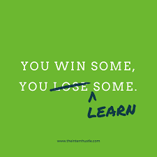
Success & Failure
You win some you lose some!
If you don’t succeed with a grant application, always seek feedback to help you understand where your application was lacking or where others were super strong
A good organisation (funder) will offer this but don’t be afraid to ask if they don’t
Turn the loss into something that you can learn from and that will help you next time!
Suggested actions
Record, keep all submissions, and responses
Calculate win/loss ratio – for future consideration
Notes:
The GPT stands for "Generative Pre-trained Transformer,"

Slide 31

The Search for funding
Searching for funding is hard work, so let’s explore a few things that might make it a little more straight forward
Products
Have all your products/plans/services developed and ready to go
Be prepared to adapt your product
Find funders who have similar objectives
Explore contribution-based funding

Slide 32

The Search for funding
Some useful sites – Toolkit – direct funders & search sites
Local - Community Foundations
National - National Lottery
Umbrella organisations – e.g., NCVO
Register for updates
Become members
Action
Develop ideas
Use online search portals
Join membership groups
Train as many people as possible
Forge partnerships and collaborations

Slide 33
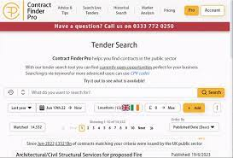
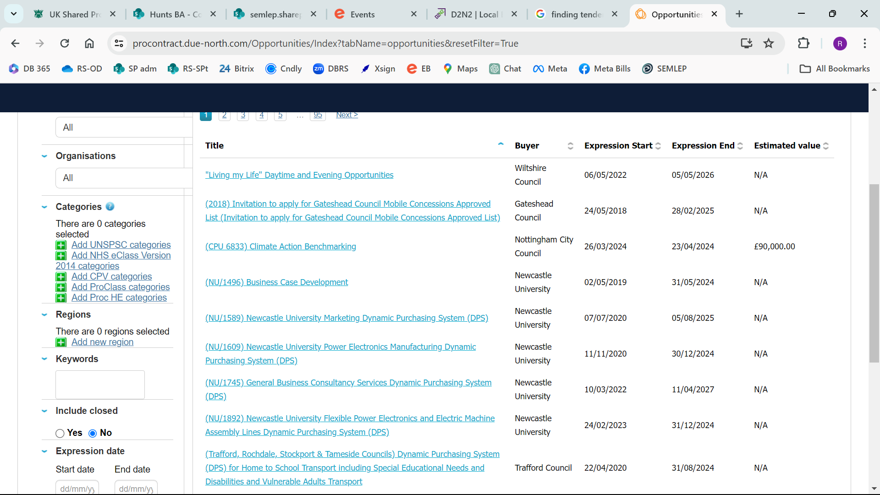
The Search for funding
Tenders
Develop relationships with private companies
Local Authorities – watch their websites and platforms
Government- WWW.gov.uk
Local Enterprise Partnerships
Universities
Register for opportunities; e.g. Proactis-Procontract; Contract Finder; Find a Tender
Frameworks – look for opportunities
Bid writers also help with identifying clients and opportunities but there is a cost!
May need loss leader initial project to break through but don’t be too cheap!

Slide 34

We are the champions!
Funding Champions
Can you develop a lead for funding related matters within your organisation?
Could they mentor or assist other (particularly smaller or fledgling) organisations?
Could they run workshops?
Could they write newsletters?
Not mandatory, worth exploring, often a very useful resource!

Slide 35

Quick Quiz
Let’s see if you have been listening - nothing serious just a bit of fun revisiting the messages of the day!

Slide 36
1
What is the first & most important thing to do when looking at new funding opportunities?
A
B
C
Check how easy it is to fill in the application
See how much you can get
Read & understand what the funder wants to fund

Slide 37
1
What is the first & most important thing to do when looking at new funding opportunities?
A
B
C
✓
Check how easy it is to fill in the application
See how much you can get
Read & understand what the funder wants

Slide 38
2
What should you do if there is anything in the criteria that you are unsure about?
A
B
C
Google it
Ask the funder
Ask a colleague

Slide 39
2
What should you do if there is anything in the criteria that you are unsure about?
✓
A
B
C
Google it
Ask the funder
Ask a colleague

Slide 40
3
What key information must you have when putting together a funding application?
A
B
C
Lots of time
Support
Strong evidence of need

Slide 41
3
What key information must you have when putting together a funding application?
A
B
C
✓
Lots of time
support
Strong evidence of need

Slide 42
4
What do we mean by Project Outcomes?
A
B
C
How many people were helped
The impact or difference the project will make
Who will be helped

Slide 43
4
What do we mean by Project Outcomes?
A
B
✓
C
How many people were helped
The impact or difference the project will make
Who will be helped

Slide 44
54
What are the key elements to remember when writing your application
A
B
C
Tell a story
Add some nice pictures
Demonstrate & be clear

Slide 45
54
What are the key elements to remember when writing your application
A
B
C
✓
Tell a story
Add some nice pictures
Demonstrate & be clear

Slide 46
6
What can you do to be prepared to fill out a funding application?
A
B
C
Have an idea in the back of your mind
Hire an application writer
Have the project developed and ready to go

Slide 47
6
What can you do to be prepared to fill out a funding application?
A
B
C
✓
Have an idea in the back of your mind
Hire an application writer
Have the project developed and ready to go

Slide 48

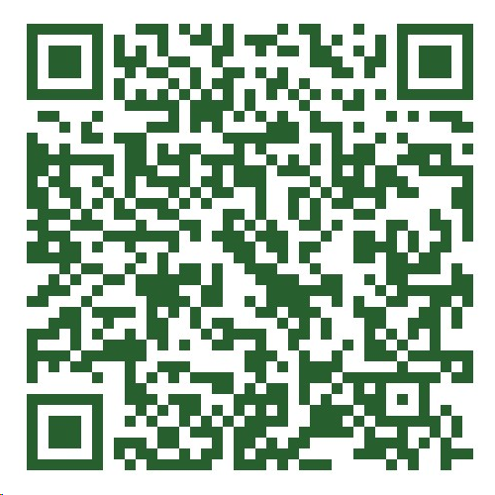
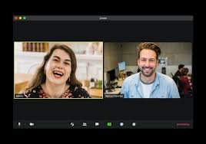

Post workshop support & Toolkit
Ongoing Support – we will be available for ongoing support during the lifetime of the UKSPF project
Toolkit – we are supplying an electronic toolkit for all attendee's post training – scan the QR code below or use the link and it will take you to the toolkit where you can download the documents
https://enterprisesupportalliance.com/high-peak-business-toolkit/

Slide 49
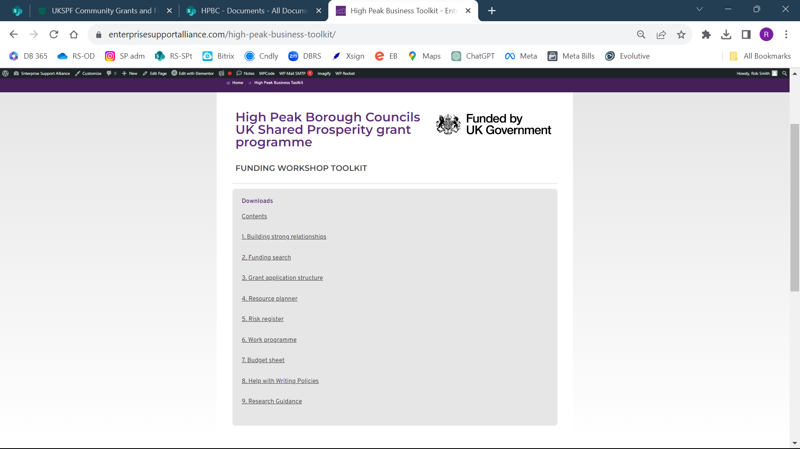

Slide 50
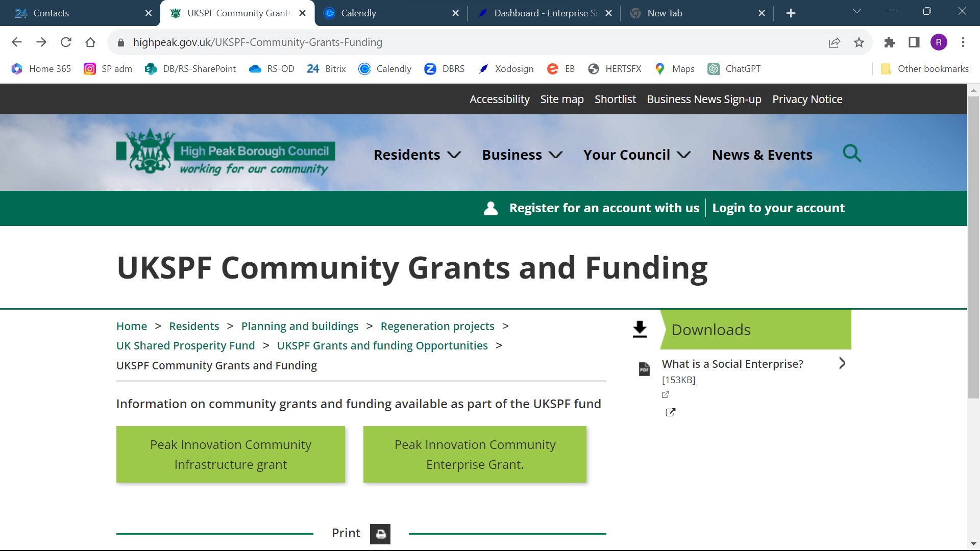
UK Shared Prosperity Fund – HPBC Community Grants
Currently being refreshed
Application process should be more comprehensive
Less need for additional information requests
Programme opens again in early May
Don’t let this put you off preparing your applications
Notes:
Grants will be funded from the UK Shared Prosperity Fund and/or the Rural England Prosperity Fund - eligible items may include:
Capital items - lasting assets such as a building improvements or equipment - you must spend grants on assets such as a building or equipment which are expected to be used for a period of at least one year. This may include enhancements to existing assets which:
Significantly lengthen the life of the asset.
Significantly increase the value of the asset.
Significantly increase usefulness of the asset.
It will not include minor repairs and routine maintenance.
Labour costs can only be funded if they are contributing directly to creating the assets e.g. builders, IT developers
Architect's fees of up to 10% and VAT may be added to the costs of eligible works provided that the professional also supervises the works on site.
A limited amount for revenue items - such as IT systems, marketing, consultancy
Grants must be for community purposes. Grant recipients cannot use grants to fund domestic property.
All successful project applicants must have completed their project, spent and claimed all of the grant by 31st January 2025, at the latest.
Applicants should note that if successful in a grant award they will be required to procure any items required in compliance with UKSPF procurement guidelines. The grant award will not cover or include any recoverable VAT incurred by your organisation and you should make your own enquiries of HMRC as to the recoverability of any VAT your organisation incurs.
Applicants will be paid in arrears for the work on completion.
All applications must take consideration of how the activity outlined will deliver in line with UK subsidy control requirements

Slide 51
UK Shared Prosperity Fund - Community Grants
Peak Innovation Community Infrastructure Grant
Grant for capacity building and infrastructure support for local Civil Society groups (Community Groups)
Capital funding, may be used to fund community spaces, e.g., as village halls, community buildings.
An increase in number of individuals engaged
Increased users of facilities or amenities
Improved facilities and accessibility
Improved experience of facilities
Peak Innovation Community Enterprise Grant
Grant for growing the local social economy, including Community Businesses, e.g., Cooperatives, social enterprises so called not for profits.
Capital funding to promote the growth of Community Businesses with an emphasis on innovation.
Jobs created/safeguarded
New social enterprises created
Enterprises with improved productivity
Enterprises adopting new technologies or processes
Enterprises adopting new or improved products or services
Notes:
Grants will be funded from the UK Shared Prosperity Fund and/or the Rural England Prosperity Fund - eligible items may include:
Capital items - lasting assets such as a building improvements or equipment - you must spend grants on assets such as a building or equipment which are expected to be used for a period of at least one year. This may include enhancements to existing assets which:
Significantly lengthen the life of the asset.
Significantly increase the value of the asset.
Significantly increase usefulness of the asset.
It will not include minor repairs and routine maintenance.
Labour costs can only be funded if they are contributing directly to creating the assets e.g. builders, IT developers
Architect's fees of up to 10% and VAT may be added to the costs of eligible works provided that the professional also supervises the works on site.
A limited amount for revenue items - such as IT systems, marketing, consultancy
Grants must be for community purposes. Grant recipients cannot use grants to fund domestic property.
All successful project applicants must have completed their project, spent and claimed all of the grant by 31st January 2025, at the latest.
Applicants should note that if successful in a grant award they will be required to procure any items required in compliance with UKSPF procurement guidelines. The grant award will not cover or include any recoverable VAT incurred by your organisation and you should make your own enquiries of HMRC as to the recoverability of any VAT your organisation incurs.
Applicants will be paid in arrears for the work on completion.
All applications must take consideration of how the activity outlined will deliver in line with UK subsidy control requirements

Slide 52
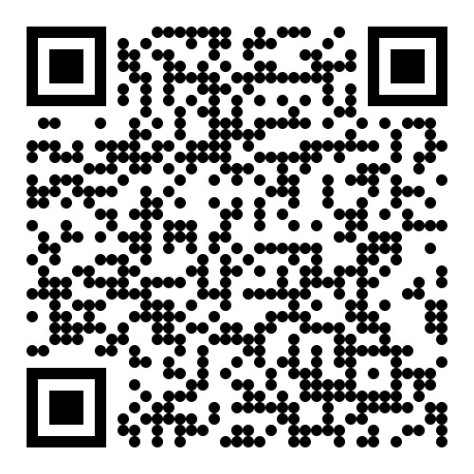
UK Shared Prosperity Fund Community Grants
More information here - www.highpeak.gov.uk/UKSPF-Community-Grants-Funding
Grants between £2k and £40k
Principally capital
20% match funding (cash)
Closing dates for applications
Community Infrastructure - 31/01/2025
Community Enterprise - 31/01/2025
It is recognised that some groups and business may find support and/or guidance helpful, consequently support is provided by ESA for both grant programmes.

Slide 53

Any questions, thoughts or comments
Thank you for taking part!
Please use the feedback forms
Robert Smith
07467 893630
robsmith@enterprisesupportalliance.com
Sophie Satchell
07554118850
Sophie@enterprisesupportalliance.com

